Slide 1


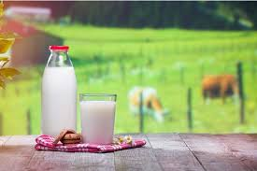
Practical milk hygiene
Stage: 5th
Sensory Evaluation of Milk
Lecture prepared
By
Sara S. Mohammed
Department of Veterinary Public Health
College of veterinary medicine
university of basrah

Slide 2
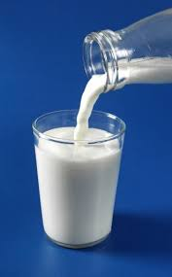
Introduction:
Milk is one of the most important foods for human nutrition. Because it is highly nutritious, it is also highly susceptible to contamination and spoilage. Therefore, evaluating milk quality is essential to ensure public health and food safety.
One of the simplest and fastest methods used to assess milk quality is sensory evaluation. This method depends on human senses such as sight, smell, taste, and touch to detect abnormalities in milk.
Sensory evaluation is widely used in dairy farms, milk collection centers, and dairy industries as a preliminary quality control method before laboratory testing.

Slide 3
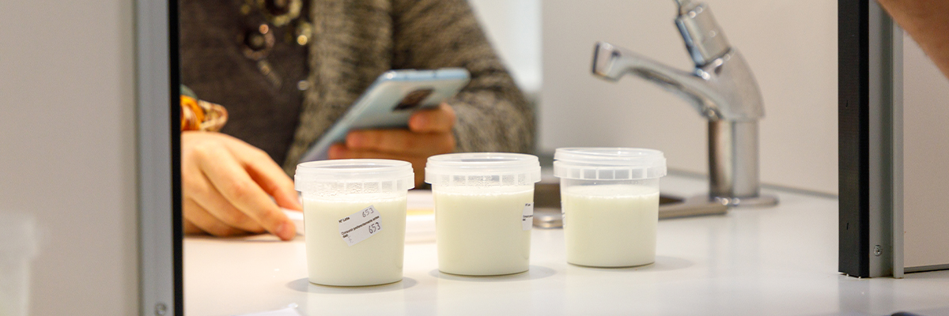
2. Definition of Sensory Evaluation
Sensory evaluation of milk is defined as:
A scientific method that uses human senses to evaluate the characteristics of milk such as appearance, odor, taste, and texture in order to determine its quality and acceptability.

Slide 4
3. Importance of Sensory Evaluation;
Sensory evaluation is important because it:
1-Provides a rapid and inexpensive method for milk quality assessment.
2-Helps in early detection of milk spoilage.
3-Supports quality control in dairy industries.
4-Helps identify defects caused by feeding, diseases, or contamination.
5-Contributes to ensuring food safety and consumer protection.

Slide 5

4. Sensory Attributes of Milk
Sensory evaluation mainly involves four parameters:
Appearance (Color and clarity)
Odor (Smell)
Taste
Texture or mouthfeel

Slide 6

A. Visual Examination (Appearance)
The first step in sensory evaluation is visual inspection.
The examiner observes:
Color
Clarity
Presence of foreign particles
Consistency

Slide 7
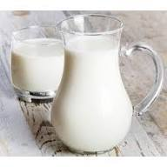
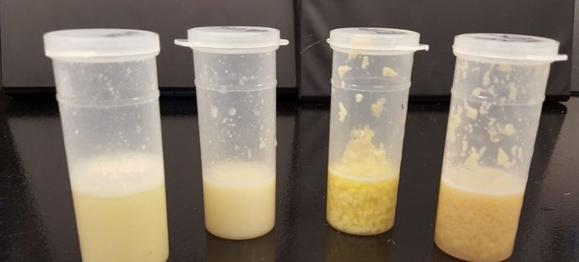
Normal milk color:
Milk normally has a pearl white color with a slight yellowish tint, mainly due to fat and carotene.
Abnormal colors and possible causes;
Color | Possible Cause
Yellow | Colostrum or high carotene content
Red or pink | Presence of blood (mastitis or injury)
Blue | Certain bacterial contamination
Watery appearance | Adulteration with water

Slide 8

B.Odor Evaluation (Smell)
Odor evaluation is performed by smelling the milk immediately after opening the container.
Normal odor:
Fresh milk has a slightly sweet and clean odor
Abnormal odors and causes;
Odor | Cause
Sour odor | Lactic acid fermentation
Feed odor | Strong feed consumed by animals
Rancid odor | Fat decomposition
Medicinal odor | Drug residues or disinfectants

Slide 9

C.Taste Evaluation
Taste evaluation is done by tasting a small amount of milk, but only when the sample is considered safe.
Normal taste:
Fresh milk has a slightly sweet and pleasant taste due to lactose.
Abnormal tastes:
Taste | Cause
Sour | Bacterial fermentation
Bitter | Protein breakdown
Salty | Mastitis
Metallic | Reaction with metal containers

Slide 10
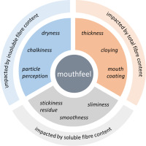
D. Texture and Mouthfeel
Texture evaluation involves assessing the physical consistency of milk.
Normal milk should be:
Smooth
Homogeneous
Free from clots or particles

Slide 11
Abnormal texture;
Texture Change | Cause
Clot formation | Increased acidity
Cream separation | Improper storage
Slimy texture | Growth of certain bacteria

Slide 12

Common Sensory Defects in Milk
Some common defects detected through sensory evaluation include:
Sour milk – caused by bacterial fermentation.
Rancid flavor – caused by fat breakdown.
Feed flavor – transferred from animal feed.
Oxidized flavor – caused by exposure to oxygen or light.
Medicinal flavor – due to drug residues or disinfectan

Slide 13
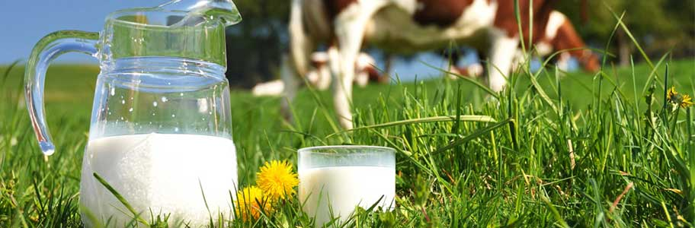
Factors Affecting Sensory Quality of Milk
Several factors influence milk sensory characteristics:
Animal species (cow, buffalo, sheep, goat).
Animal feed.
Animal health status, especially mastitis.
Milking hygiene.
Storage temperature.
Storage duration

Slide 14
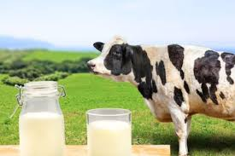
Steps of Sensory Evaluation
The general procedure includes:
Collecting a representative milk sample.
Performing visual examination.
Evaluating the odor.
Assessing taste (if safe).
Observing texture and consistency.
Recording results in a sensory evaluation form

Slide 15
Example of Sensory Evaluation Form
Attribute | Excellent | Good | Acceptable | Poor
Color | □ | □ | □ | □
Odor | □ | □ | □ | □
Taste | □ | □ | □ | □
Texture | □ | □ | □ | □

Slide 16
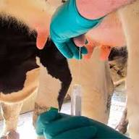
Role of Veterinarians
Veterinarians play an important role in milk quality control through:
Monitoring animal health
Detecting mastitis
Ensuring hygienic milking practices
Supervising milk quality in dairy farms

Slide 17
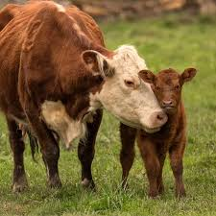
THANKS FOR LISTENING

